Slide 1
7
SERIES OF FUNCTIONS
Copyright © Cengage Learning. All rights reserved.

Slide 2
7.4
Applications of Taylor Polynomials
Copyright © Cengage Learning. All rights reserved.

Slide 3
Approximating Functions
by Polynomials

Slide 4
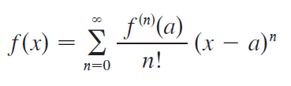

Approximating Functions by Polynomials
Suppose that f (x) is equal to the sum of its Taylor series at a:
We have introduced the notation T_{n}(x) for the nth partial sum of this series and called it the nth-degree Taylor polynomial of f at a.
Thus

Slide 5



Approximating Functions by Polynomials
Since f is the sum of its Taylor series, we know that
T_{n}(x) → f (x) as n → and so T_{n} can be used as an approximation to f : f (x) ≈ T_{n}(x).
Notice that the first-degree Taylor polynomial
is the same as the linearization of f at a.

Slide 6
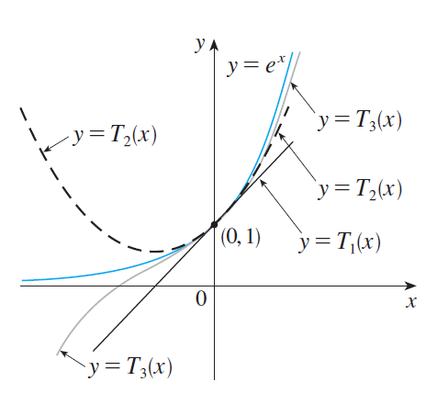
Approximating Functions by Polynomials
Notice also that T₁ and its derivative have the same values at a that f and f ′ have. In general, it can be shown that the derivatives of T_{n} at a agree with those of f up to and including derivatives of order n.
To illustrate these ideas let’s
take another look at the graphs
of y = e^{x} and its first few Taylor
polynomials, as shown in
Figure 1.
Figure 1

Slide 7
Approximating Functions by Polynomials
The graph of T₁ is the tangent line to y = e^{x} at (0, 1); this tangent line is the best linear approximation to e^{x} near
(0, 1).
The graph of T₂ is the parabola y = 1 + x + x²/2, and the graph of T₃ is the cubic curve y = 1 + x + x²/2 + x³/6, which is a closer fit to the exponential curve y = e^{x} than T₂.
The next Taylor polynomial T₄ would be an even better approximation, and so on.

Slide 8
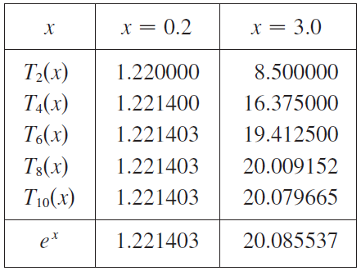
Approximating Functions by Polynomials
The values in the table below give a numerical demonstration of the convergence of the Taylor polynomials T_{n}(x) to the function y = e^{x}.

Slide 9

Approximating Functions by Polynomials
We see that when x = 0.2 the convergence is very rapid, but when x = 3 it is somewhat slower. In fact, the farther x is from 0, the more slowly T_{n}(x) converges to e^{x}.
When using a Taylor polynomial T_{n} to approximate a function f, we have to ask the questions: How good an approximation is it?
How large should we take n to be in order to achieve a desired accuracy? To answer these questions we need to look at the absolute value of the remainder:

Slide 10

Approximating Functions by Polynomials
There are three possible methods for estimating the size of the error:
1. If a graphing device is available, we can use it to graph
and thereby estimate the error.
If the series happens to be an alternating series, we
can use the Alternating Series Estimation Theorem.

Slide 11
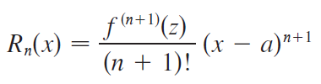
Approximating Functions by Polynomials
In all cases we can use Taylor’s Formula which says
that
where z is a number that lies between x and a.

Slide 12




Example 1
(a) Approximate the function by a Taylor
polynomial of degree 2 at a = 8.
(b) How accurate is this approximation when 7 ≤ x ≤ 9?
Solution:
(a)

Slide 13



Example 1 – Solution
cont’d
Thus the second-degree Taylor polynomial is
The desired approximation is

Slide 14
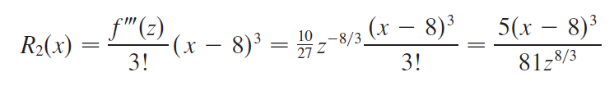


Example 1 – Solution
cont’d
(b) The Taylor series is not alternating when x < 8, so we
can’t use the Alternating Series Estimation Theorem in
this example.
But using Taylor’s Formula we can write
where z lies between 8 and x.
In order to estimate the error we note that if 7 ≤ x ≤ 9,
then –1 ≤ x – 8 ≤ 1, so and therefore

Slide 15


Example 1 – Solution
cont’d
Also, since z > 7, we have
and so
Thus if 7 ≤ x ≤ 9, the approximation in part (a) is
accurate to within 0.0004.

Slide 16
Applications to Physics

Slide 17
Applications to Physics
Taylor polynomials are also used frequently in physics.
The physicist uses a Taylor polynomial as an approximation to the function. Taylor’s Formula can then be used to gauge the accuracy of the approximation.
The next example shows one way in which this idea is used in special relativity.

Slide 18


Example 3
In Einstein’s theory of special relativity the mass of an object moving with velocity v is
where m₀ is the mass of the object when at rest and c is the speed of light.
The kinetic energy of the object is the difference between its total energy and its energy at rest:

Slide 19



Example 3
cont’d
Show that when v is very small compared with c, this
expression for K agrees with classical Newtonian
physics:
(b) Use Taylor’s Formula to estimate the difference in
these expressions for K when
Solution:
(a) Using the expressions given for K and m, we get

Slide 20
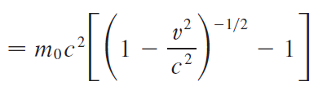



Example 3 – Solution
cont’d
With x = –v²/c², the Maclaurin series for (1 + x)^{−1/2} is most easily computed as a binomial series with
(Notice that because v < c.)
Therefore we have

Slide 21


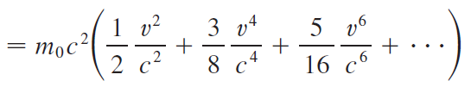

Example 3 – Solution
cont’d
and
If v is much smaller than c, then all terms after the first are very small when compared with the first term. If we omit them, we get

Slide 22
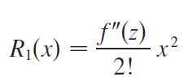


Example 3 – Solution
cont’d
(b) By Taylor’s Formula we can write the remainder term as
where f(x) = m₀c²[(1 + x)^{−½} – 1] and x = –v²/c².
Since
we get
where z lies between 0 and –v²/c².

Slide 23

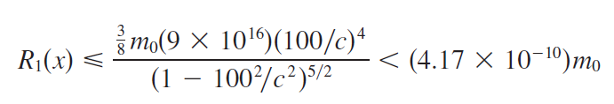
Example 3 – Solution
cont’d
We have c = 3 × 10⁸ m/s and
so
Thus when the magnitude of the error in
using the Newtonian expression for kinetic energy is at
most (4.2 × 10⁻¹⁰)m₀.

